Slide 1
Unit II Data representation and manipulation
Amanpal Singh

Slide 2
Table of content
filter, advanced filter for complex criterion
sorting and custom sorting
pivot table and pivot chart
power pivot: import data from different sources into power pivot
reducing file size in power pivoting
connect to multiple different external datasets
DAX functions

Slide 3
1. Filter, advanced filter for complex criterion
Use filters to temporarily hide some of the data in a table, so you can focus on the data you want to see.
Select any cell within the range.
Select Data > Filter.
Select the column header arrow .
Select Text Filters or Number Filters
Next Advance Filter

Slide 4
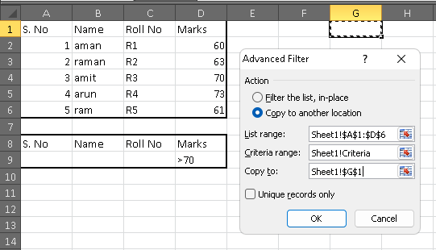
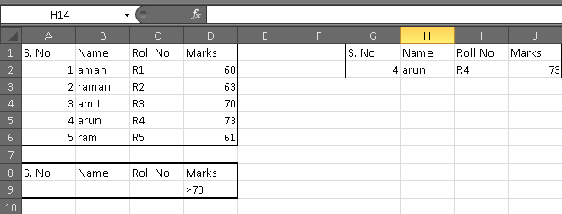
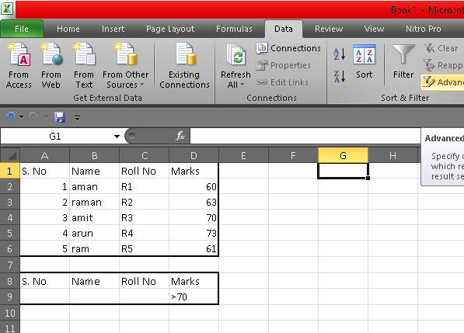
Advance Filter

Slide 5
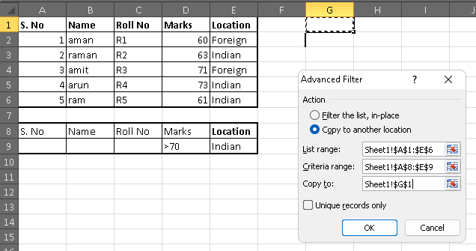
Advance filter AND

Slide 6
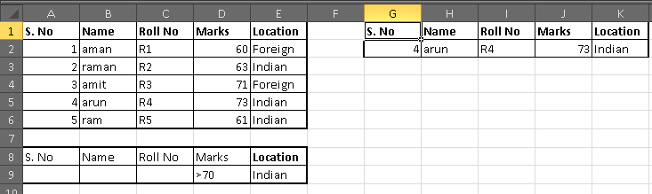
Contd…

Slide 7
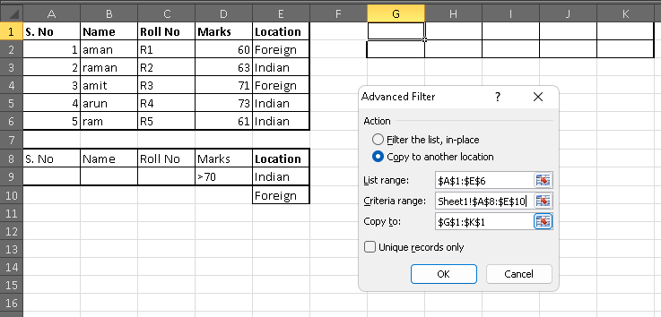
Advance filter OR

Slide 8
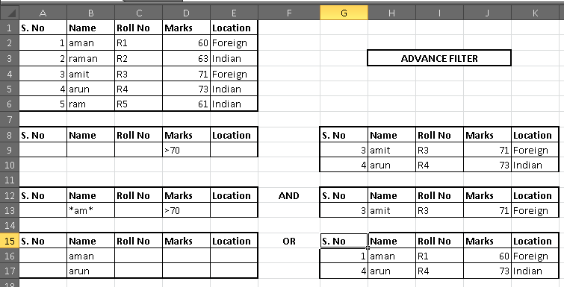
Advance filter summery

Slide 9
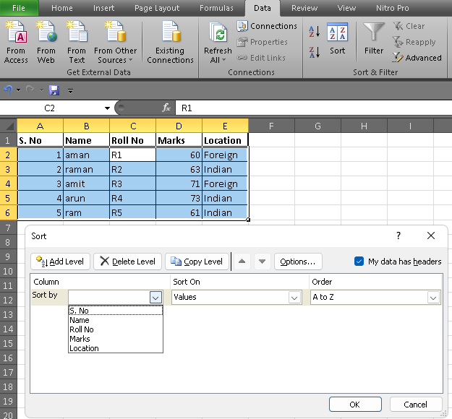
2. sorting and custom sorting

Slide 10
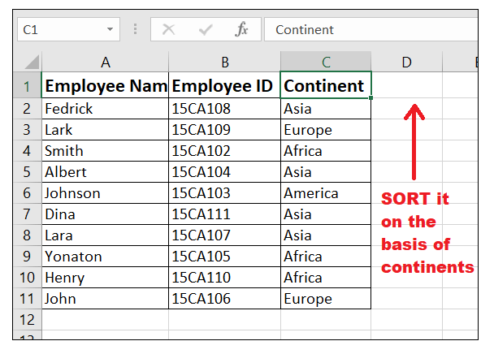
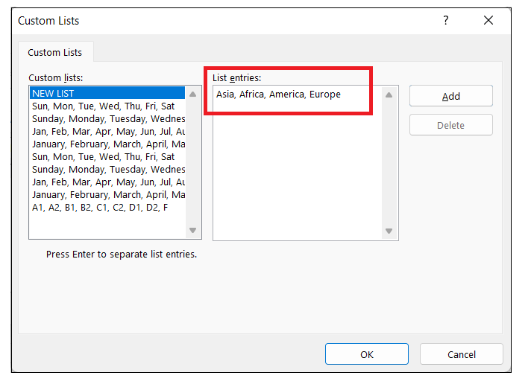
Custom sort Eg.

Slide 11
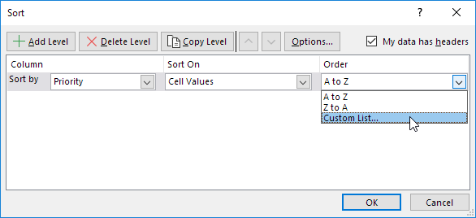
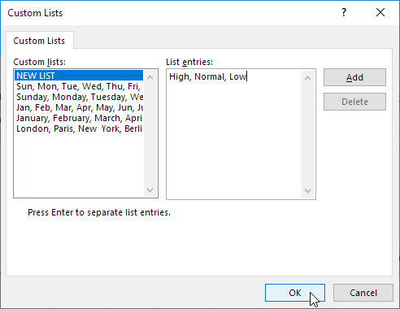
Custom sort

Slide 12
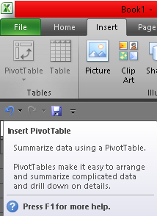
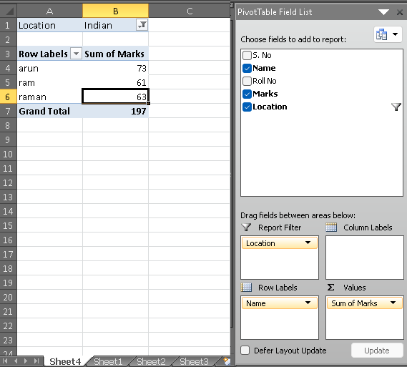
3. pivot table and pivot chart, power pivot

Slide 13
pivot table
An Excel Pivot Table is a tool to explore and summarize large amounts of data, analyze related totals and present summary reports designed to:
Present large amounts of data in a user-friendly way.
Summarize data by categories and subcategories.
Filter, group, sort and conditionally format different subsets of data so that you can focus on the most relevant information.
Rotate rows to columns or columns to rows (which is called "pivoting") to view different summaries of the source data.
Subtotal and aggregate numeric data in the spreadsheet.
Expand or collapse the levels of data and drill down to see the details behind any total.
Present concise and attractive online of your data or printed reports.
https://www.ablebits.com/office-addins-blog/excel-pivot-table-tutorial/

Slide 14
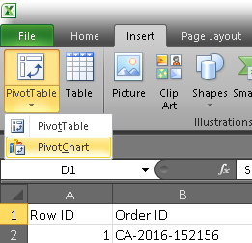
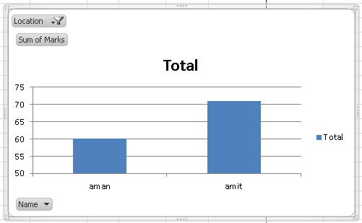
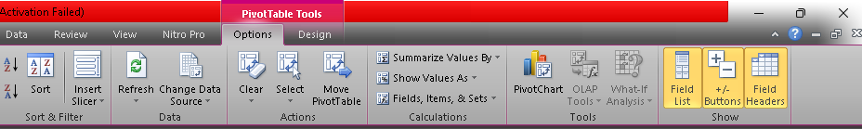
pivot chart

Slide 15
4. Power Pivot
It is part of Microsoft's business intelligence stack capable of big data analytics work without specialty infrastructure or software.
It enables you to import millions of rows of data from multiple data sources into a single Excel workbook.
Power Pivot is expressed by Microsoft using DAX (Data Analysis Expressions), which is a collection of functions, operators, and constants.
Notes:
https://www.toptal.com/finance/excel-experts/powerpivot-for-excel-use-cases-and-tutorial

Slide 16
Contd…
Ability to easily import data from multiple sources:
Microsoft Azure
SQL Server
Teradata
Facebook
Salesforce
JSON files
Excel workbooks
…and many more

Slide 17
4.1 Power Pivot installation
Download the PowerPivot for Microsoft Excel (for older versions, skip for newer version)using link below:
https://www.microsoft.com/en-ph/download/details.aspx?id=43348
Notes:
https://www.myexcelonline.com/blog/installing-power-pivot-excel-2010/

Slide 18
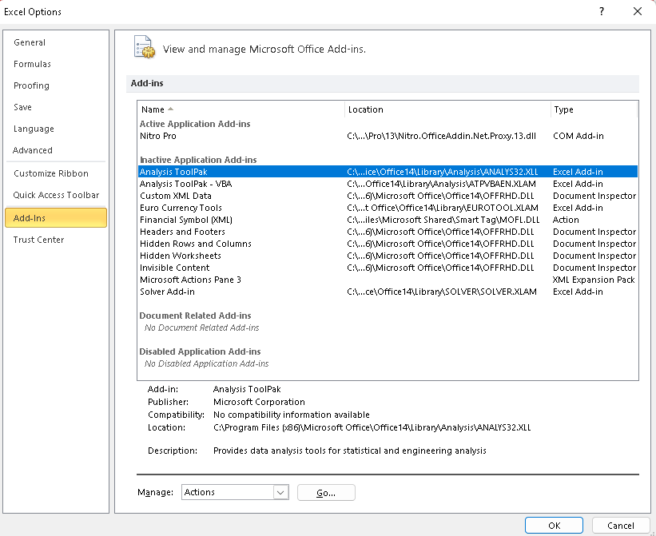
enable power pivot: add-in

Slide 19
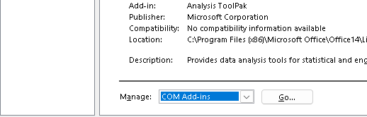
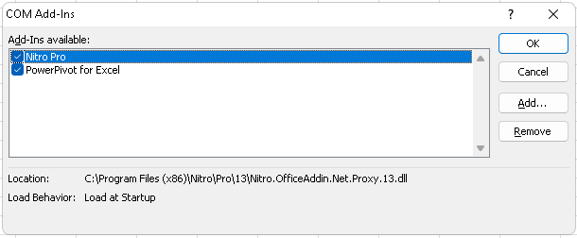
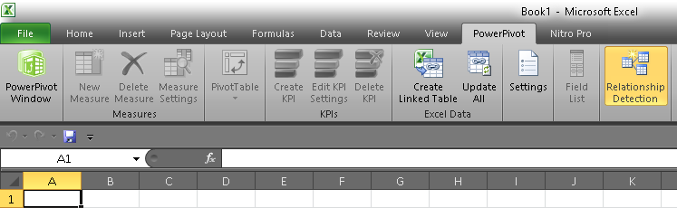
Contd…

Slide 20
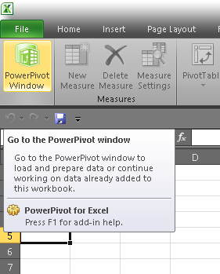
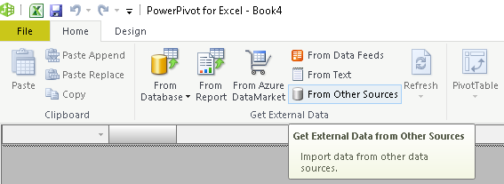
4.1 Import data from different sources into power pivot

Slide 21
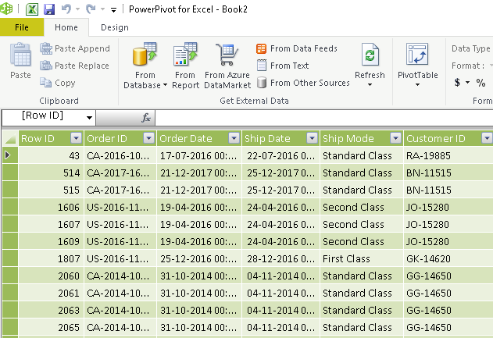

Slide 22
4.1.1 KPIs
Key performance indicators (KPIs) are visual measures of performance.
Supported by a specific calculated field, a KPI is designed to help users quickly evaluate the current value and status of a metric against a defined target.

Slide 23
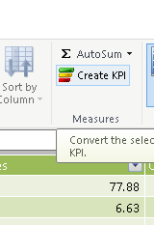
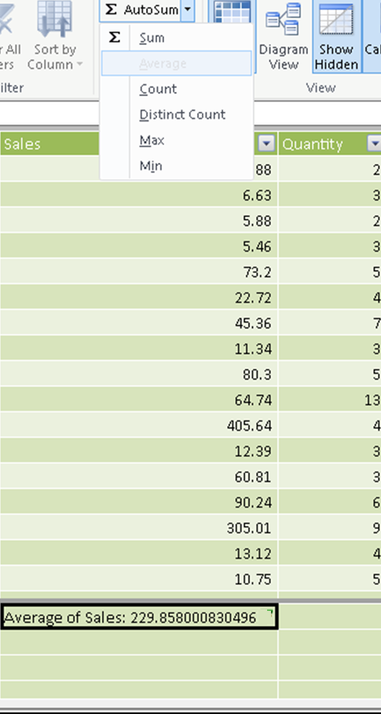
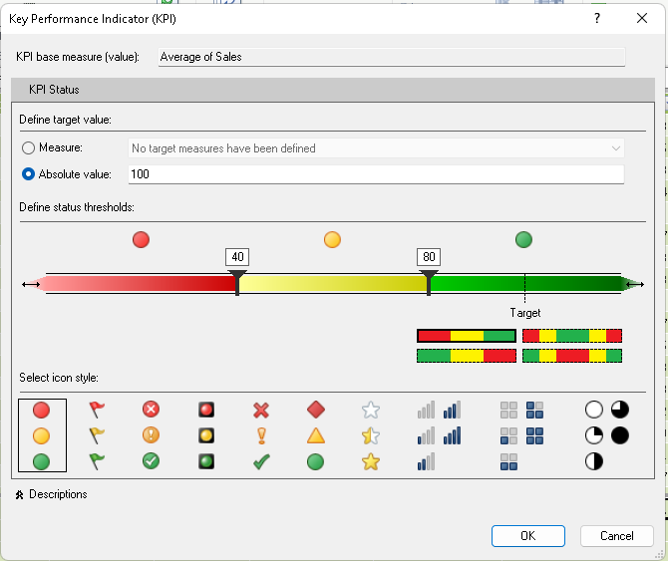

KPI
Create measure first (with avg. in this case)

Slide 24
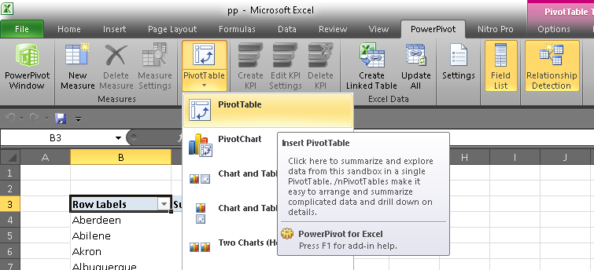
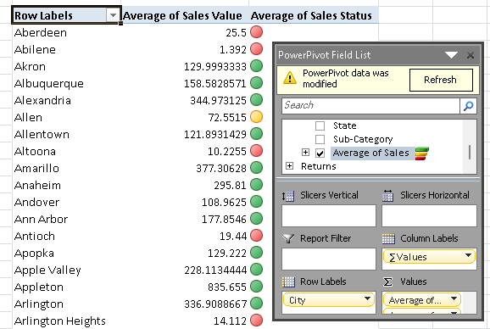
Kpi contd…

Slide 25
5. Reducing file size in power pivoting
Save your spreadsheet in binary (.xslb) format
Reduce the number of worksheets (blank)
Don't save the pivot cache with the file
by not saving the pivot table source data cache with the file and instead having the data cache refresh when you open the spreadsheet.
See the next slide for options.
Notes:
https://support.microsoft.com/en-us/office/reduce-the-file-size-of-your-excel-spreadsheets-c4f69e3a-8eea-4e9d-8ded-0ac301192bf9#:~:text=If%20your%20spreadsheet%20contains%20a,the%20PivotTable%20group%2C%20select%20Options.

Slide 26
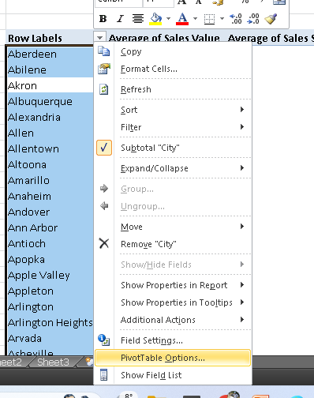
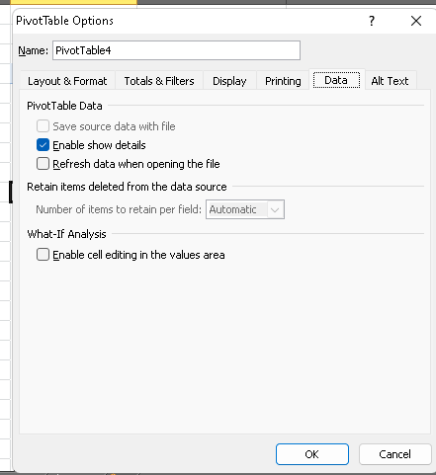
Don't save the pivot cache …

Slide 27
6. connect to multiple different external datasets
Working with three distinct sets of data, each stored in separate sheets within a single Excel file.
By importing multiple data sets into this model, they can be integrated, allowing for more comprehensive pivot tables.
When using the Power Pivot data model, be aware that data is stored in both the spreadsheet and the data model, leading to increased file sizes.
Notes:
https://www.mpug.com/harnessing-the-power-of-excels-power-pivot-for-multiple-data-sets/

Slide 28
7. DAX functions
Data Analysis Expressions (DAX)
DAX is a formula language.
DAX formulas are different, it can returns a table as its result, rather than a single value.
These functions can be used to provide input to other functions.
When you define a formula for an explicit measure, nothing happens until you add the measure into a PivotTable.
Notes:
https://support.microsoft.com/en-us/office/data-analysis-expressions-dax-in-power-pivot-bab3fbe3-2385-485a-980b-5f64d3b0f730

Slide 29
Contd..
DAX functions never take
a cell reference or
a range as reference,
but instead DAX functions take a column or table as reference.
https://learn.microsoft.com/en-us/dax/dax-function-reference [DAX function reference]
Notes:
https://support.microsoft.com/en-us/office/data-analysis-expressions-dax-in-power-pivot-bab3fbe3-2385-485a-980b-5f64d3b0f730

Slide 30
DAX function contd…
In general, a DAX formula in a column is always applied to the entire set of values in the column (never to only a few rows or cells).
Refer the screen-short in the next slide.
https://www.tutorialspoint.com/excel_dax/excel_dax_formulas.htm

Slide 31
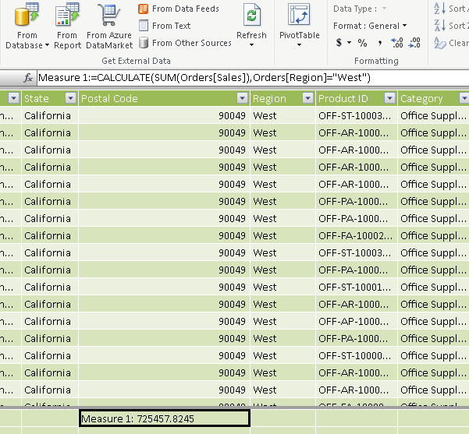
DEX formula example

Slide 32
CALCULATE
SUM
AVERAGE
COUNT
MIN/MAX
CONCATENATE (dimension)
https://www.linkedin.com/pulse/22-powerful-dax-formulas-functions-beginners-deep-bi-samson/

Slide 33
Similarities Between Excel Functions and DAX Functions
Certain DAX functions have the same name and the same general behavior as Excel functions.
DAX has lookup functions that are similar to the array and vector lookup functions in Excel.

Slide 34
Differences Between Excel Functions and DAX Functions
You cannot use DAX functions in an Excel formula or use Excel functions in DAX formula, without the required modifications.
Excel functions take a cell reference or a range of cells as a reference. DAX functions never take a cell reference or a range of cells as a reference, but instead take a column or table as a reference.
Excel date and time functions return an integer that represents a date as a serial number. DAX date and time functions return a datetime data type that is in DAX but not in Excel.
Read more at:
https://www.tutorialspoint.com/dax_functions/dax_functions_quick_guide.htm

